Slide 1
Computer Vision and Image Processing
Tirgul 10
Optical Flow
& Moriya Bitton

Slide 2
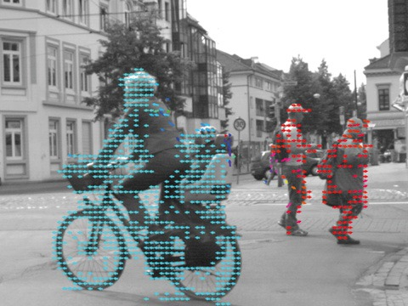


What is optical flow?
“Optical flow or optic flow is the pattern of apparent motion of objects, surfaces, and edges in a visual scene caused by the relative motion between an observer and a scene” - Wikipedia

Slide 3

Representation
Direction ($α$)
Magnitude (scalar)

Slide 4
Why do we need Optical flow?
Tracking
Movement detection (of an object)
Motion estimation (of the camera)
Video compression
Three-dimensional structure estimation of the scene
etc..

Slide 5
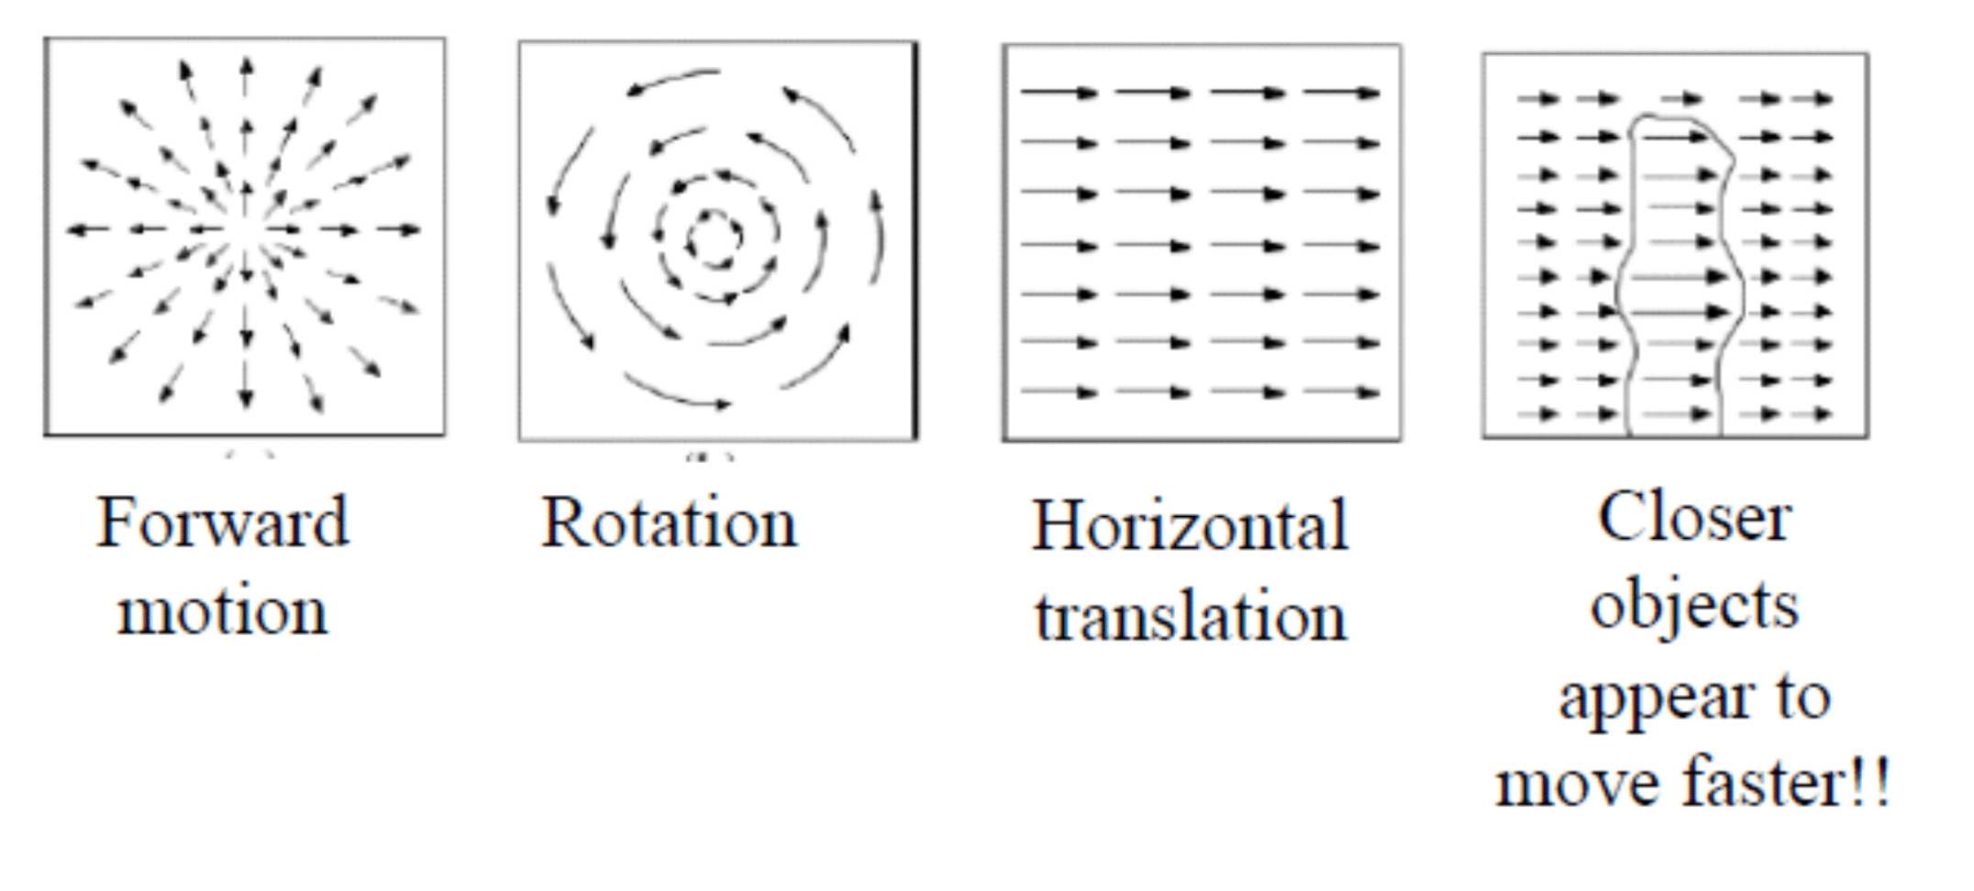

Slide 10
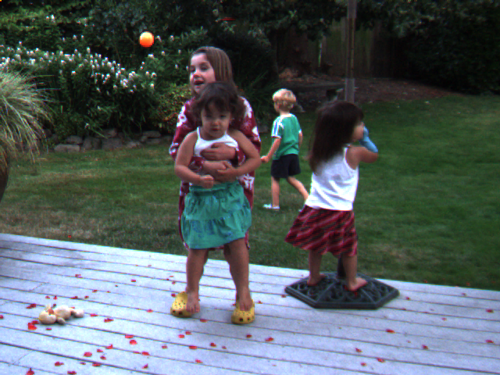
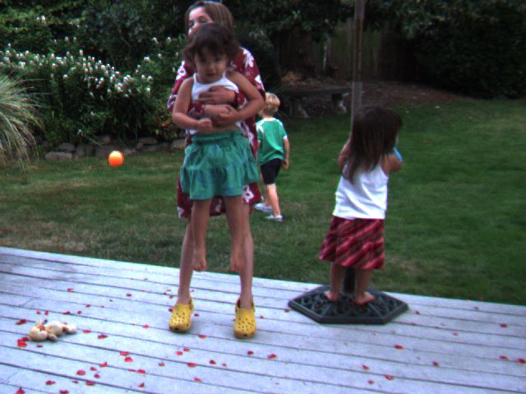
How to find the optical flow of a video?

Slide 11
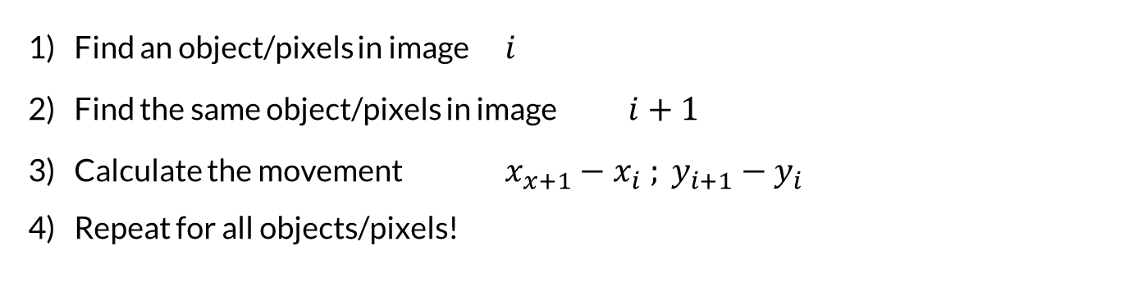
Idea out line
Find an object/pixels in image $i$
Find the same object/pixels in image $i+1$
Calculate the movement $x_{x+1}−x_{i} ; y_{i+1}−y_{i}$
Repeat for all objects/pixels!

Slide 12
Problems
How to find an object in the first place? How to define an “object”?
Where to look for the object in the second image? Search the whole image?
Will the object look the same?
How to do it quickly?

Slide 13
Lucas & Kanade Optical flow Algorithm (1981)
Assumptions:
Color consistency Assume the object will look the same in adjacent images.
Proximity Assume the object will not move too much in between images (frames).

Slide 14
But how do we find an object?
Instead of looking for an object, let’s divide the frame to squares.
Find each square in the next image using cross correlation.

Slide 15

Compute time?
For ever (Like the time it took to make)
Translation(u, v) →$n^{2}$
+ Rotation(u, v,$α$) → $n^{3}$
+ Zoom (u, v,$α$, scale) → $n^{4}$

Slide 16

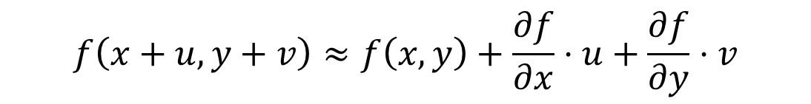
Solution
Taylor approximation:
For small $(u,v)$ and function $f$ (image):
$$f\left(x+u,y+v\right)≈f\left(x,y\right)+\frac{∂f}{∂x}⋅u+\frac{∂f}{∂y}⋅v$$

Slide 17

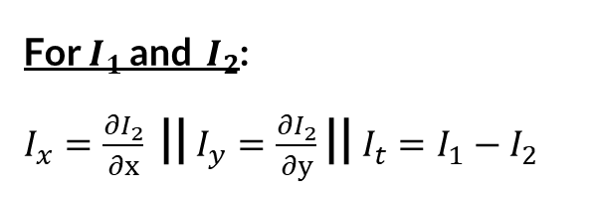
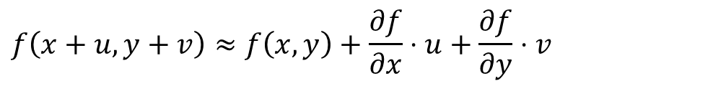
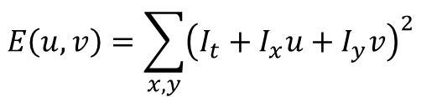
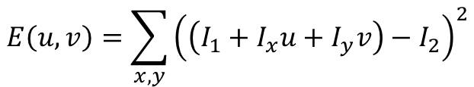
Lucas & Kanade
We need to find a $(u,v)$ that minimizes:
$$f\left(x+u,y+v\right)≈f\left(x,y\right)+\frac{∂f}{∂x}⋅u+\frac{∂f}{∂y}⋅v$$
$$E\left(u,v\right)=\sum_{x,y}{{\left(\left(I_{1}+I_{x}u+I_{y}v\right)−I_{2}\right)}^{2}}$$
For $I_{1}$ and $I_{2}$: $I_{x}=\frac{∂I_{2}}{∂x}$ || $I_{y}=\frac{∂I_{2}}{∂y}$ || $I_{t}=I_{1}−I_{2}$
$$E\left(u,v\right)=\sum_{x,y}{{\left(I_{t}+I_{x}u+I_{y}v\right)}^{2}}$$

Slide 18


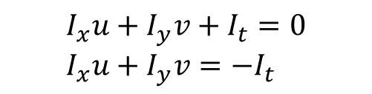
Lucas & Kanade
Choose small windows (common practice is $5X5$),
and find the $\left(u,v\right)$ that satisfies the movement.
$$I_{x}u+I_{y}v+I_{t}=0 \\ I_{x}u+I_{y}v=−I_{t}$$
$$\left[\begin{matrix}I_{x}[1] & & I_{y}[1] \\ ⋮ & & ⋮ \\ I_{x}[n] & & I_{y}[n]\end{matrix}\right]⋅\left|\begin{matrix}u \\ v\end{matrix}\right|=−\left|\begin{matrix}I_{t}\left[1\right] \\ ⋮ \\ I_{t}\left[n\right]\end{matrix}\right|$$

Slide 19
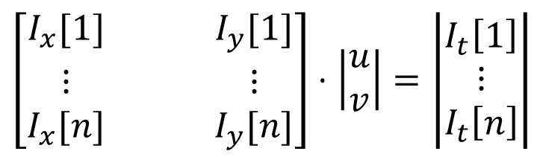
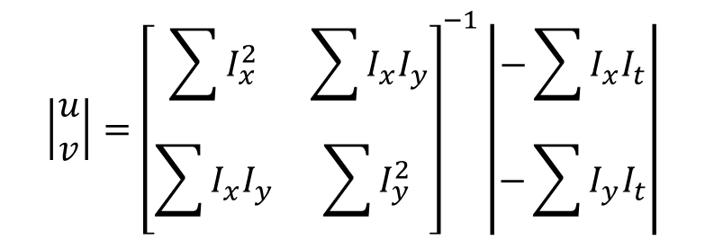
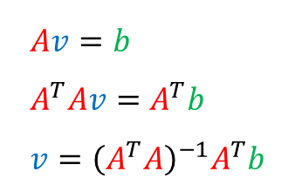
Lucas & Kanade
$$Av=b \\ A^{T}Av=A^{T}b \\ v={\left(A^{T}A\right)}^{−1}A^{T}b$$
$$\left[\begin{matrix}I_{x}[1] & & I_{y}[1] \\ ⋮ & & ⋮ \\ I_{x}[n] & & I_{y}[n]\end{matrix}\right]⋅\left|\begin{matrix}u \\ v\end{matrix}\right|=\left|\begin{matrix}I_{t}\left[1\right] \\ ⋮ \\ I_{t}\left[n\right]\end{matrix}\right|$$
$$\left|\begin{matrix}u \\ v\end{matrix}\right|={\left[\begin{matrix}\sum{I_{x}^{2}} & \sum{I_{x}I_{y}} \\ \sum{I_{x}I_{y}} & \sum{I_{y }^{2}}\end{matrix}\right]}^{−1}\left|\begin{matrix}−\sum{I_{x}I_{t}} \\ −\sum{I_{y}I_{t}}\end{matrix}\right|$$

Slide 20
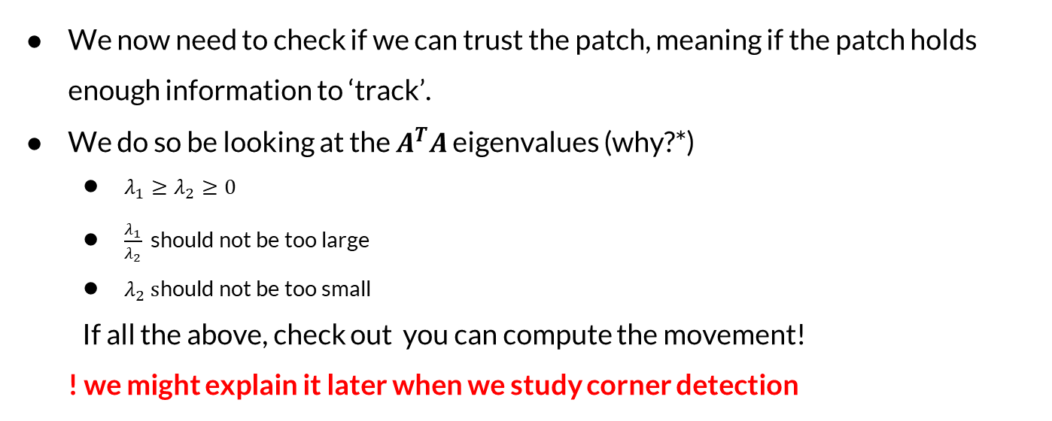
Lucas & Kanade: Additional checks
We now need to check if we can trust the patch, meaning if the patch holds enough information to ‘track’.
We do so be looking at the $A^{T}A$ eigenvalues (why?*)
$λ_{1}≥λ_{2}≥0$
$\frac{λ_{1}}{λ_{2}}$ should not be too large
$λ_{2} s$hould not be too small
If all the above, check out you can compute the movement!
! we might explain it later when we study corner detection

Slide 21
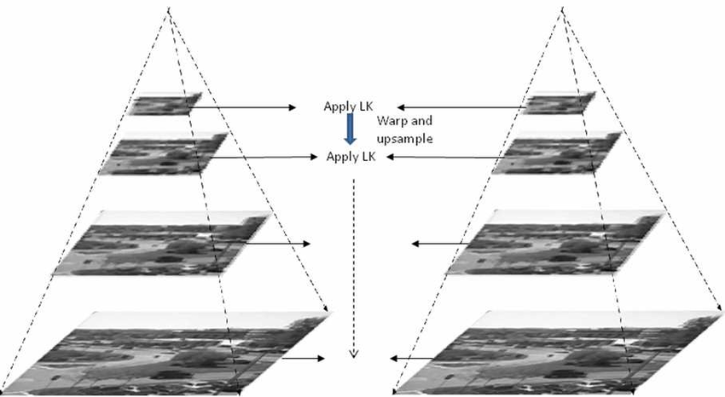
How to detect large movements?

